Slide 1
Promotions and Discounts

Slide 2
Discounts, Offers & Promotions: Context
Currently we have no method for offering discounts, offers or promotions to customers.
For now we have been using manual workaround whereby the customer pays a certain amount and then KOKO manually credits their account with money to bring them up to the order price.
This has served us to date but now the volumes are too high.
The manual process (prone to error) has a significant time burden for Sales and CX / AX teams; as well as causing some customer comms confusion.
All orders are being processed at the same price which means we can’t really track discounts or extrapolate certain groups from our sales data e.g. v5 swaps who received their cookers for free.

Slide 3

Feature Vision
Vision Increase the perceived value for money to drive KOKO Cooker sales |  | KPIs Promotion uptake (% of the potential customer segment) ALPU from promotions (or promotion customers)
Who is this for? Customers! Anthony (Sales) identifies a group of customers who are keen to buy but need incentivisation Allie (CX), responsible for updating accounts with discounts, sending comms and managing complaints for updating customer accounts Ari / Paul / Shahzad who are looking at how to drive sales in Nairobi and what Rono (MKTG) running competitions with prizes | The Big Picture 3 months to get 35k in sales > we are 5% of the way there. Customer feedback indicates the price is high Different levers can incentivise certain key customer groups e.g. influencers, first customers, business owners, corporate customers Desirable: Run multiple campaigns at the same time which could affect the same users. Create something flexible enough that it can be reused for multiple promotions. |  | Benefits Encourage existing customers to close their savings orders New orders for new customers Save time for Sales and Ops to free them up to support sales of Cookers e.g. Understand levers that can be used to influence a customer to buy Allow us to get more fuel users
Create a customer segment
Create the discount / offer
Apply discount
Tracking & Financial reconciliation

Slide 4
Sample promotions
How we target customers | Sample Campaigns (past, present, future)
Target customers based on attributes in KOKO Core e.g. customer type, sales channel, neighborhood. Target customers based on their behaviours e.g. regularity of top ups and fuel purchases Individuals we want to reward | Stove for those half way through the savings journey
 | 2000 KES off Agent Cooker Price
 | 2200 KES for KOKO employees
 | Discounts for a large company e.g. Safaricom
 | Fuel discounts for high fuel users
 | Fuel discounts for low fuel users
There are 3 key levers for promotions:
KOKO Credit
Adding to the product offer e.g. extra canister
Decreasing product price

Slide 5
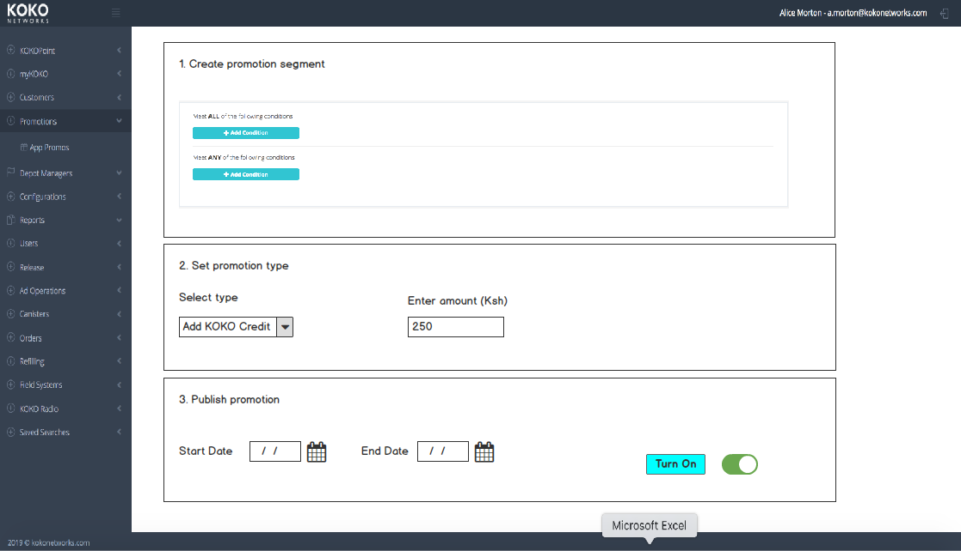
Solution Outline
Create a simple rules engine in KOKO Core:
Allows for the creation of segments based on behaviours
Allows us to use 3 key levers
User can set dates for campaign.
There should also be a second page where the user can see all the promotions running and toggle them on and off at short notice.
Questions
Should there be an approval step for setting a promotion?
Could be as simple as a notification email?

Slide 6
Use Case 1: Lower Product Price
At a high level - we would be adding these functionalities:
Create a campaign - a campaign is a rule(s) based on a set of criteria e.g. behaviours, attributes in KOKO Core.
Customer is eligible for a lower price:
They are shown a lower order price on our apps
The lower price is stored against any orders in KOKO Core
When the customer reaches their full order price for an item the order is triggered in Odoo.
The difference between product price and order price (classified as a ‘promotion’ expense) is passed as a journal entry in Odoo when the customer’s order is placed.
KOKO Core
Campaign creation
Pricing ‘layer’ to reflect eligible price in apps
Odoo
Journal entry for the promotion amount

Slide 7
Use Case 2: Credit incentives for fuel
Create customer segment based on rules:
Rule 1 = Customer is from company x
Rule 2 = Customer made a fuel purchase today
Set bonus type: Add KOKO Credit to value of y
The value of the bonus (classified as a ‘promotion’ expense) is passed as a journal entry in Odoo each time the bonus is triggered.
KOKO Core
Campaign creation
Trigger bulk admin top up
Odoo
Journal entry for the promotion amount

Slide 8
Use Case 3: Give a customer a canister
Create customer segment based on rules:
Rule 1 = Customer has bought a kit
Rule 2 = Customer is part of a group e.g. kibanda
Rule 3 = Customer bough kits between date x and y
Set bonus type: Give away a canister
Creates a canister order and tops up the amount of the canister
The value of the top up (classified as a ‘promotion’ expense) is passed as a journal entry in Odoo each time the bonus is triggered.
KOKO Core
Campaign creation
Bulk order creation and top up
Odoo
Journal entry for the promotion amount

Slide 9
Impacted systems
The challenge we face is our customer CRM is currently KOKO Core while our ERP resides in Odoo.
Any solution is relatively complex because it will need to involve both systems to combine offers and discounts with targeting for customers.
KOKO Core is proprietary which makes it relatively easy to build upon
Odoo is a enterprise ERP so it offers many of these features out the box.
The working assumption is building something in KOKO Core will be significantly quicker as it will have less impact on APIs and can leverage existing functionality.
KOKO Core
Customers and their data
Odoo
Pricing & Products

Slide 10
Security and Non functionals
Feasibility to be discussed with engineering team.
Security
Only users with the permission ‘Promotions’ can access this functionality in KOKO Core.
There should be a cap on the value of the individual promotion account e.g. Ksh 2000 for a discount on product price.
We should send an email to EXCO whenever a campaign is running so they are aware and can cascade as appropriate.
We should separate out the automated refund from order cancellations to de-risk the opportunity for customers to get free money.
Are additional approvals required when setting a campaign?
Non-functionals
The system should be available 99.0% of the time. Given we are building on KOKO Core this should be achievable.
Once a campaign is set eligible customers should be able to get their bonus within x hours.
Once a campaign is set eligible customers should be able to see the updated price on the app within x hours.
Adding a condition to a campaign should have a load time of max 5 seconds.
Setting a campaign should take max 10 seconds and be supported by a success pop up in KOKO Core.

Slide 11
Next steps
Discuss with stakeholders [Ari / Sagun / Micael]
Plan for resourcing in Team Meeting [Micael]
Final designs for KOKO Core [Rahul]
Close out outstanding designs and business questions [Alice]

Slide 12
Wireframes
Draft for feedback

Slide 14
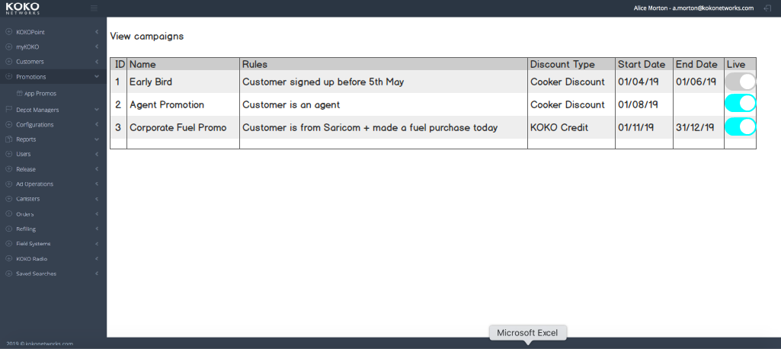
Users can view campaigns past & present + turn them off

Slide 15
Appendix material

Slide 16
Levers
There are a few ways we can provide a discount to the customer.
Type | Priority
KOKO Credit | High - we can do this today but only at an individual level. Doing it on mass is time intensive
MPESA Credit | Low - we have a way to do this today via the MPESA portal
Reduce product price | Medium - only way to do this is manual crediting - labour intensive + creating false data
Add item to product e.g. extra canister | Medium - need a lot of spare canisters before we can do this

Slide 17
High level journey - cooker discounts / additional offerings
Option 1 - KOKO Core led
Option 2 - Odoo led (long term option)
Create customer segment in KC
Apply discount in KC
Push updated price to Odoo
Account for difference
Create customer segment in KC
Push to Odoo
Push updated price back to KOKO Core

Slide 18
Implementation architecture
(Work in progress)

Slide 19
Definitions and Principles
Promotion definition in KOKO Core:
A promotion is defined by:
Active flag to turn it on and off (at point of serving it)
A start date and end date
Product it applies to
A name and plain english description of the rule that the promotion delivers (for browsing)
Top up required to deliver promotion - defines how much a user
Promotion value in KSh
An eligibility script (written by engineering team):
contains the code which identifies customers that qualify for the promotion
updates promotion mapping table with customers who are eligible for it
Send SMS to customer notifying them that they are eligible for promotion (if appropriate)
An action script that executes when promotion is availed (written by engineering team)
contains code that will perform the promotion action based on customer topping up with specified amount and being eligible for the promotion
action code could do anything but typically would
crediting a customer and send an SMS
update promotion as availed by customer in promotion mapping table
odoostore ref to order in promotion mapping
store ref to promotion in order
A total budget for the promotion in KSh
If budget reached then promotion action is no longer executed
Promotions engine principles:
Eligibility scripts runs periodically (e.g. overnight, or even within day if necessary) to update eligible customers for promotions
Action script run when a customer tops up, but should also be able to be launched manually from customer page in case trigger was missed, or if CX wants to override logic in exceptional circumstances (“how do I give this user this promotion right now”?)
If more than one promotion applies to a customer when they top up, the most recently unavailed promotion action script will be executed.

Slide 20
Allocation process / mechanism
Every 24 hrs
Eligibility definition
Promo definition
Run eligibility script 1
Promo Mapping table
[Cust ID, Promo ID, Availed, Additional Info]
e.g.
[Gladys, Xmas promo, Yes, {OrderID:2938}]
Promo table
[Promo ID, Promo definitions]
e.g.
[Xmas promo, Promo details]
Updates
mappings of which promotions apply to which users for a product
Rules engine executes over entire customer base taking into account latest data that impacts on promotion applicability under the promotion’s rule logic
Run eligibility script 2
Run eligibility script 3
Run eligibility script 4
Run eligibility script 5
Exceptional (non rule based) mappings could be added on a case by case basis

Slide 21
Mechanism to serve KOKO credit based promotion
KOKOpoints and myKOKO would not be used to serve a credit based promotion since the marketed sale price would be the same. Awareness of the promotion would be via:
Text
Radio
Social

Slide 22
Mechanism to serve discounted product
NOT DOING
Odoo product details
[Product details, Price, etc...]
e.g.
[Cooker Kit, 6999]
Promo Mapping table (KOKO Core)
[Cust ID, Prod ID, Promo ID]
e.g.
[Gladys, Cooker Kit, Xmas promo]
[Gladys, Cooker Kit, High user deal]
[Gladys, Cooker Kit, weekend special]
Promo table (KOKO Core)
[Promo ID, Discount, ...]
e.g.
[Xmas promo, 1000]
[High user deal, 500]
[Weekend special, 1500]
Regular price of 6999 is discounted by
1. finding that three promotions apply to Gladys.
2. choosing the most valuable.
3. modifying product API to incorporate promo (price/image)
Product API
KOKOpoint buy product screen (existing)
Price = 5499 KSh
Image = Weekend special image

Slide 23
Mechanism to avail a discounted product
NOT DOING
Pre-order / order
Include:
[Promo ID / Discounted price / Discount Amount ]
e.g.
[Weekend Special, 5499, 1500]
When product is purchased
1. Promotion parameters copied into (pre)Order
2. When discounted price reached, discounted amount is credited from KC promotions account to reach full product price (Odoo price)
3. Rest of process continues as normal
Use case for Odoo journal entry should be same as when we do an Admin transfer?
Product API
KOKOpoint buy product screen (existing)
Price = 5499 KSh
Image = Weekend special image

Slide 24
Other considerations (MdC scratchpad)
Additional needs:
We would need to be able to test promotion rule code/script to check customers it would apply to
Record summary of how many customers qualify for each promotion after the rule engine has run, each time it is run?
Store the promotion that applied in the pre-order/order for onward tracking and accounting
Do we need to rerun promotion rules engine for specific customers after they top up ? (may activate a promotion that we want to be available immediately)
Do we need to be able to see the promotions that apply to any customer in the customer details page?
… ??

